Slide 1

Leading Causes of Death in United States
By -
Pratyush Painuly
Mohammad Shiwani
Brandon Valmont

Slide 2
Motivation & Summary
Investigate the distribution of Death around the country on a macro and micro level
How does mortality rate measure for different causes, states and on a global scale.
Analyse what factors affect the death rate and is there a correlation with other countries?

Slide 3
Questions & Data
How does Mortality rate of United States compare with other countries?
How does it look statewide?
What factors have an affect in the mortality rate?

Slide 4
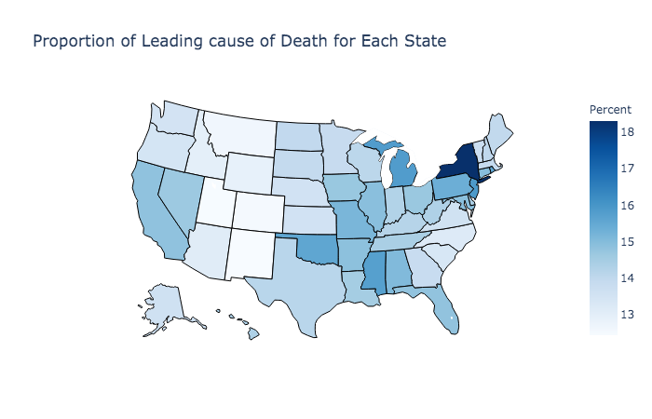
United States Death Rate - Nationwide Outlook
Heart Disease is the leading cause for 41 states
Heart Disease dominates New York and New Jersey
18 of 20 biggest cities of US belong to the state with Heart Disease as the leading cause. WORK LIFE BALANCE?
New Mexico has the lowest proportion of heart Disease.
Choropleth Map using Plotly

Slide 5
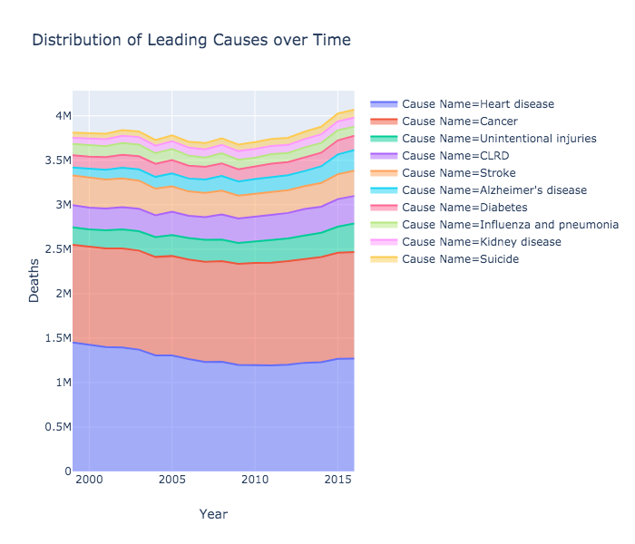
Heart Disease, Cancer account for 55% of all deaths.
Suicide and Kidney Disease, Diabetes and Alzheimer’s trending up.

Slide 6
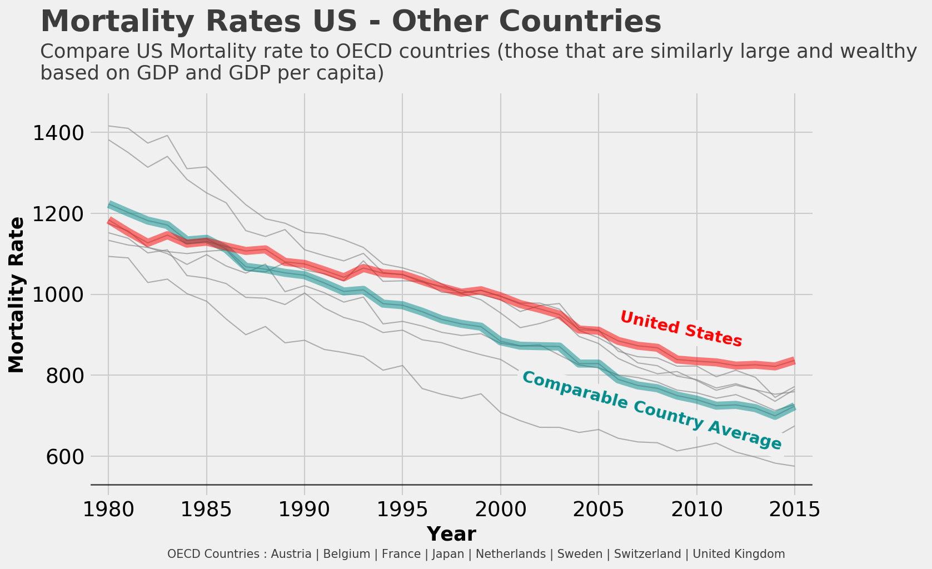
OECD - Organization for Economic Co-operation and Developement index
Highest Mortality Rate -
UNITED STATES
Most Spent on Medicare -
UNITED STATES

Slide 7
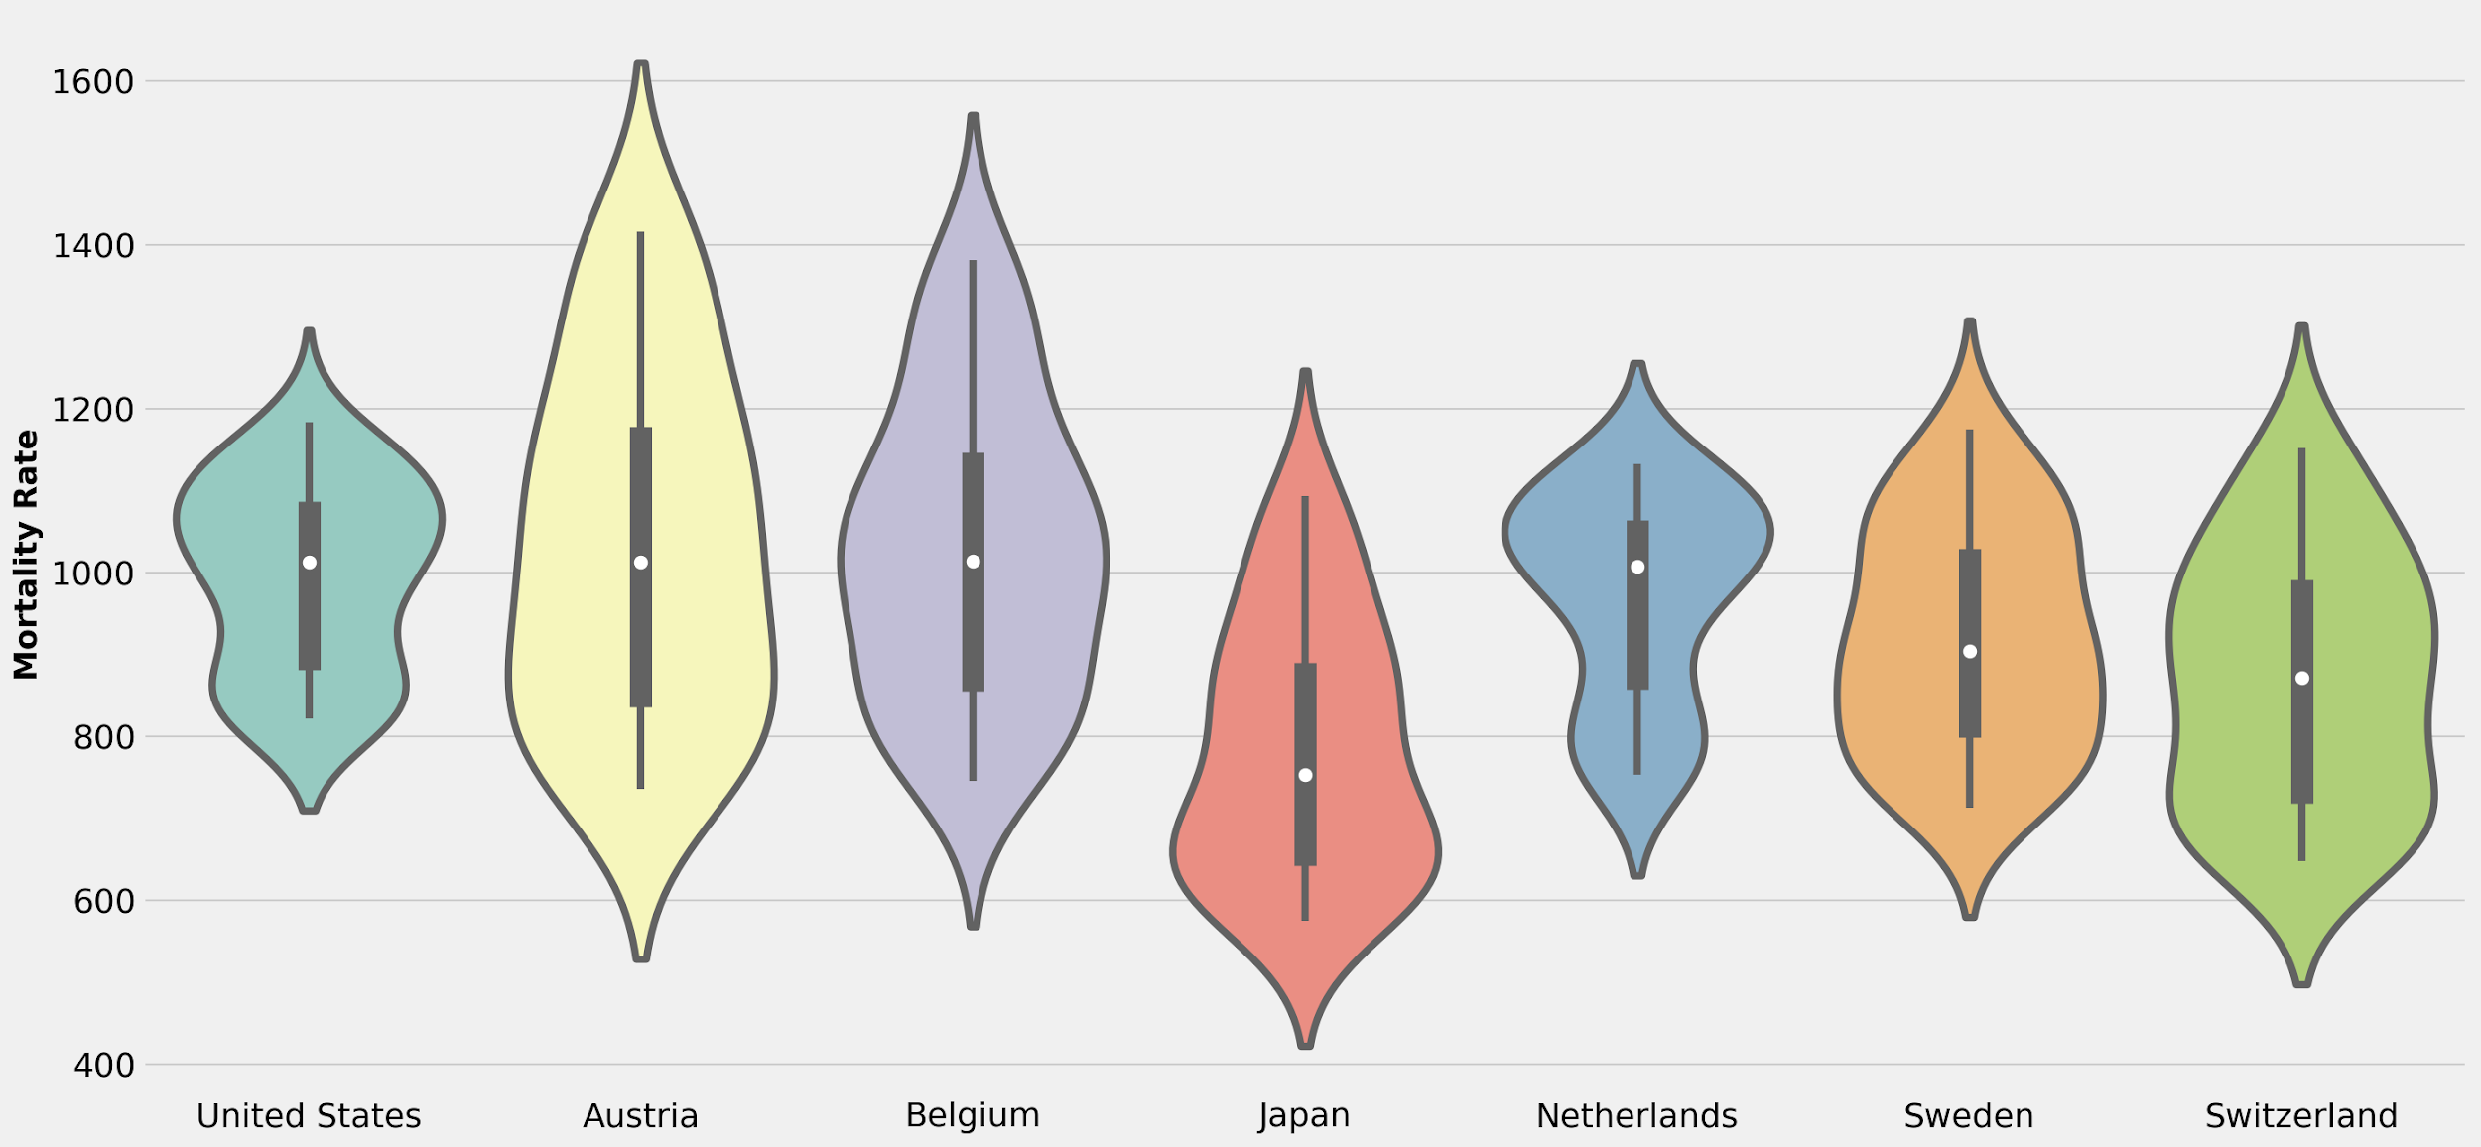
Does size and wealth of a country indicate mortality Rate?
F_onewayResult(statistic=12.224121776617295, pvalue=5.036253643447928e-12)

Slide 8
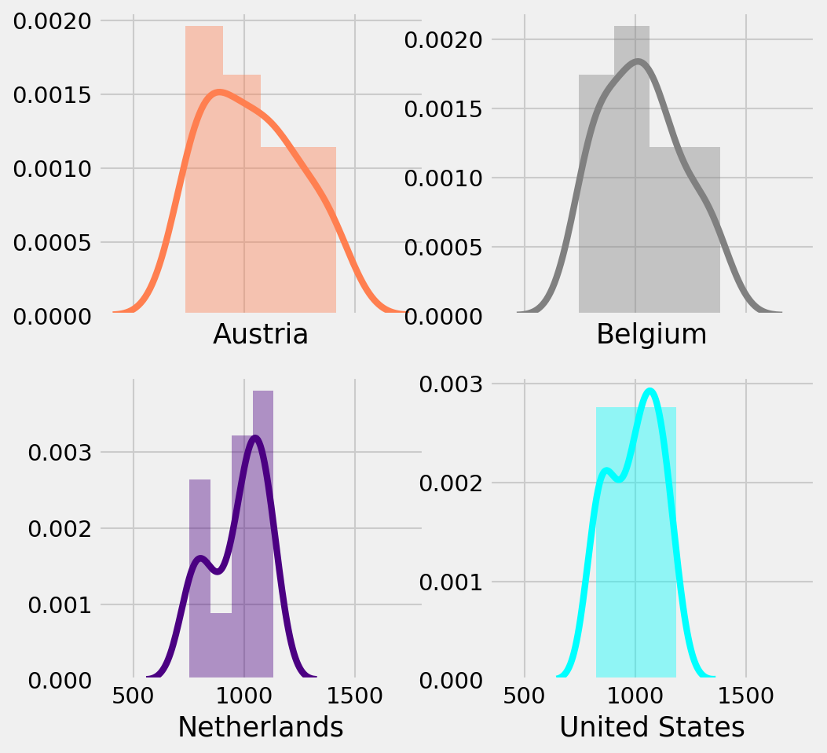
But, What if the subset is Significant?
F_onewayResult(statistic=1.129188689957743, pvalue=0.3394977866922905)
P value = 0.33
Null Hypothesis Accepted
Mortality Rate Dataset for Japan, Belgium, Netherlands and United States is significant.

Slide 9
Leading Causes of Death in United States
Kidney disease
Suicide
Alzheimer's disease
Influenza and pneumonia
Diabetes
Stroke
Heart disease
Cancer
CLDR
Unintentional injuries

Slide 10
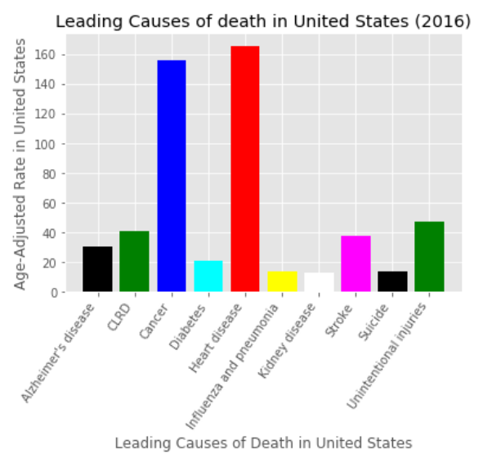
Leading Causes of Death in United States
How is death rate distributed nationwide?

Slide 11
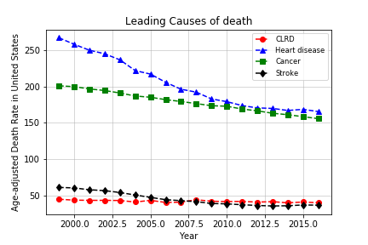
Leading Causes of Death in United States

Slide 12
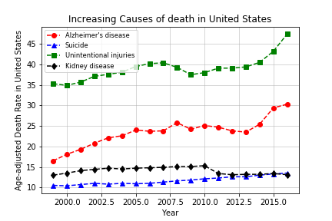
Increasing Causes of Death

Slide 13
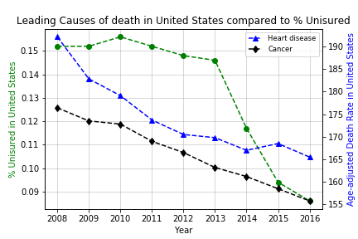
Leading Causes compared to % Uninsured

Slide 14
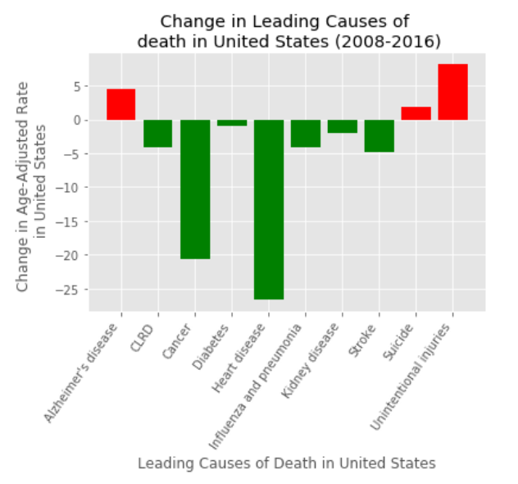

Slide 15
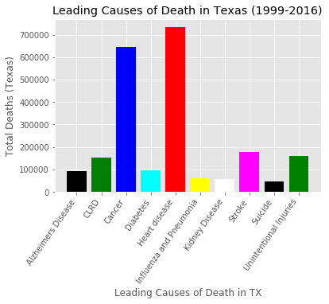
Leading Causes of Death in TX
How is death rate distributed statewide?

Slide 16
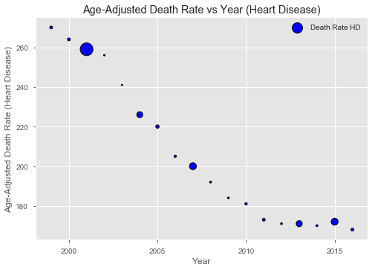
Age-Adjusted Death Rate for Heart Disease (TX)

Slide 17
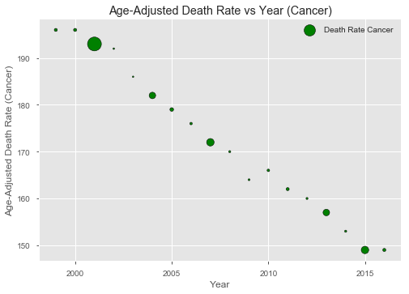
Age-Adjusted Death Rate for Cancer (TX)

Slide 18
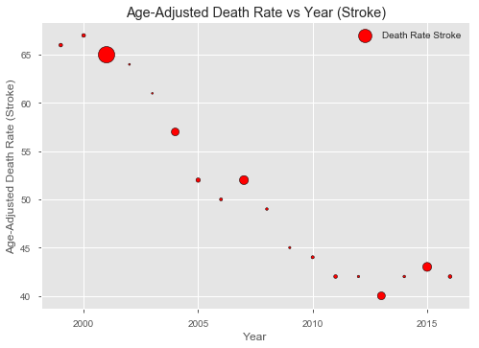
Age-Adjusted Death Rate for Stroke (TX)

Slide 19
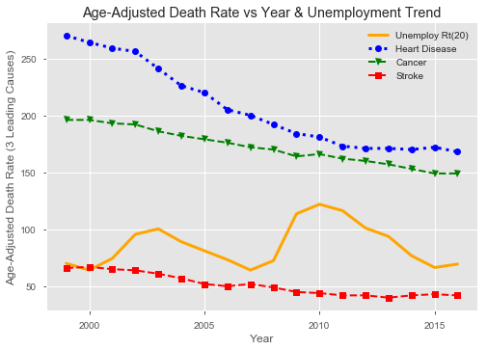
TX Unemployment Trend vs 3 Leading Causes Rates

Slide 20
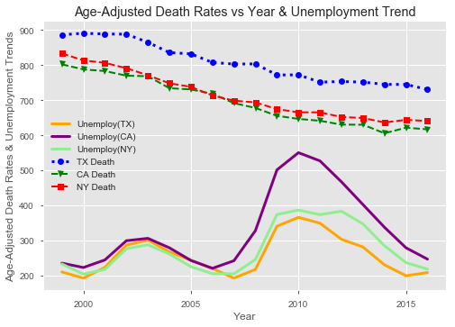
Unemployment Trends vs Death Rates

Slide 21
Research Findings
Heart Diseases, Cancer and Stroke are the three leading causes of Death in United States.
Suicide rates and Alzheimer's Disease rates are on the rise
New York has the highest distribution of a leading cause for state(Heart Diseases in this case).
Texas had lower unemployment rates compared to California and New York, but a higher age-adjusted death rate overall.
For Stroke and Heart Diseases, there was a spike in Texas. We investigated if that had a correlation with the Major Oil and Gas Downturn on 2015 and consequently unemployment rates for Texas.
Since 1985, United States has the worst Mortality rate(per 100000 people) when compared to other countries of "similar" size and wealth.
We formed our null hypothesis that Countries of similar wealth and size will have a similar mortality rate. After performing ANOVA test on the dataset featuring 7 countries, the null hypothesis was rejected. However, when we take a group of 4 countries and perform the same test, the dataset is significant.

